Slide 1
Comparing Lifestyles - How our footprints impact the climate
Teaching material for classes 10 - 12

Slide 2
Inhaltsverzeichnis
1
Informationen zum Modul
Seite 3
1.1
Kurzbeschreibung & Übersicht
Seite 3
1.2
Lernziele und Kompetenzen
Seite 3
1.3
Ablauf
Seite 4
1.4
Materialübersicht
Seite 5
2
Materialien
Seite 6

Slide 3
Kurzbeschreibung
Key question: Which everyday actions and living conditions have a significant
impact on an individual‘s carbon footprint?
The list of what we can do to make our lifestyle sustainable is endless. However, the effectiveness of our choices is often debatable. With this educational material pupils learn about everyday actions and realities of life that significantly influence the footprint – the Big Points. Using the online CO₂-calculator they compare the environmental impact of two
fictitious characters – with surprising results. It is designed to help pupils dispel some of the myths about sustainable lifestyle choices.
The pupils then develop measures to reduce footprint and discuss political control instruments. With this knowledge, the pupils can identify their own approaches that contribute to a sustainable lifestyle.
Duration | 90 minutes
Classes | class 10-12
Subject | English
Key words | ecological footprint, sustainable and socially just consumer behaviour, sustainable lifestyle, questions of equality
Required prior Knowledge | Pupils are familiar with the climate crisis and know the impact of green house gases on the climate.
Materials | Working sheets, devices with internet access
Lernziele und Kompetenzen
Erkennen / Analysekompetenz
Ziel 12 Schwerpunkt des Materials ist es, Handlungen und Bedürfnisfelder zu
identifizieren, die einen
hohen Einfluss auf den
CO₂-Fußabdruck haben.
Die Schüler*innen lernen das Instrument des CO -
Fußabdrucks kennen und können diesen mit
2
unterschiedlichen Lebensstilen und Konsumweisen in Verbindung bringen.
Die Schüler*innen analysieren unterschiedliche Lebensstile
und ihren Einfluss auf das Klima.
Bewerten / Urteilskompetenz
Die Schüler*innen können wenig wirksame Maßnahmen (Peanuts) erkennen und von wirkungsvollen Alltagshandlungen (Big Points) unterscheiden und kritisch bewerten.
Handlungskompetenz
Die Schüler*innen kennen Handlungsansätze für ihren Alltag, den eigenen Fußabdruck und den anderer zu reduzieren und Maßnahmen in ihrem Umfeld umzusetzen. Sie fühlen sich selbstwirksamer gegenüber der Klimakrise.
Ziel 13
Das Material unterstützt Schüler*innen dabei, wirkungsvolle Klimaschutzmaßnahmen kennenzulernen und diese in ihrem Umfeld umzusetzen.

Slide 4
Ablauf
Phase/Dauer | Inhalt/Lernziel | Sozialform/Methode/Material
Einstieg 10 min. | Einführung ins Thema Meinungsabfrage | L1 Plenum Aufstellung im Raum
Erarbeitung 25 min. | Arbeitsphase I CO₂-Emissionen von zwei Beispielpersonen berechnen | M1, M2 Einzel- oder Paararbeit Endgerät mit Internetzugang
Auswertung & Ergebnissicherung 10 min. | Vergleich der Fußabdrücke Reflexion zu den Ursachen der Ergebnisse Schüler*innen erkennen Treiber für höhere CO₂-Emissionen Schüler*innen stellen Zusammenhang von Emissionen und Einkommen her Ergebnissicherung | Lö1, Lö2 L2, L3 Plenum Unterrichtsgespräch
Vertiefung 30-60 min. | Arbeitsphase II Entwicklung von Einsparpotenzialen Produkt: Comic / Plakat / Zeitungsartikel | M3, M4 Einzel / Paararbeit
Auswertung & Ergebnis- Sicherung 10 min. | Reflexion Potenziale und Grenzen individuellen Handelns Ableitung notwendiger ergänzender politischer Maßnahmen | Lö3, Lö4 L4 Plenum Unterrichtsgespräch
Abschluss 5 min. | What ideas can you imagine realising in the future? | Blitzlicht
Hintergrundinfos & weiterführendes Material
UBA-Bildungsportal nachhaltiger Konsum: https://denkwerkstatt-konsum.umweltbundesamt.de/wirkung UBA-Video: Big Points nachhaltigen Konsums: https://youtu.be/wC8103wu5n8 Infografiken Big Points: https://nachhaltigerkonsum.info/service/bigpoints Online-Mini-Game zu den Big Points: https://nachhaltigerkonsum.info/Minigame/ Video Handabdruck: https://www.youtube.com/watch?v=59Bg7CmW5RE

Slide 5
Materialübersicht
L
umfasst Material für die Lehrkraft / Seminarleitung:
Ablauf, Hintergrundinfos, Ergebnissicherung
Materialien für die Schüler*innen / Teilnehmenden: Arbeitsaufträge
➔ M 1-4 können sich Schüler*innen auf der Webseite unter Material für Schüler*innen
auch selbst herunterladen (ohne Lösungen etc.)
Lösungen zu den Arbeitsaufträgen
M
Lö
Materialnummer | Erläuterung | Vorbereitung
L1 | Einführung ins Thema Anleitung und Thesen Aufstellung im Raum | Für die Lehrkraft
M1 M2 | Arbeitsauftrag und Datenblatt Berechnung Fußabdruck M1 – Klaus Tabori M2 – Maria Schmitt | Drucken für die Schüler*innen / Teilnehmenden
Lö1 Lö2 | Lösung für Klaus Tabori Lösung für Maria Schmitt | Für die Lehrkraft
L2 | Vergleich der Fußabdrücke und Relevanz des Faktors Einkommen | Für die Lehrkraft
L3 | Ergebnissicherung | Für die Lehrkraft Ggf. Visualisieren
M3 M4 | Arbeitsauftrag Einsparungspotenzial mit Produkterstellung M3 – Klaus Tabori M4 – Maria Schmitt | Drucken für die Schüler*innen / Teilnehmenden
Lö3 Lö4 | Lösung für Klaus Tabori Lösung für Maria Schmitt | Für die Lehrkraft
L4 | Reflexion und Ergebnissicherung | Für die Lehrkraft Ggf. Visualisieren

Slide 6
L1: Getting started
Lining up in the room / plenary (10 min.)
For an initial opinion poll, a line-up is organised in the room. For this purpose, two points in the room are defined for the poles (who supports the thesis – who does not?). Pupils position themselves between the poles.
Theses:
Climate change worries me.
Making sustainable decisions is important to me.
Living sustainably is challenging and exhausting.
Environmental protection and sustainability are matters for high earners – because it is expensive.
I believe that our society will find good solutions to limit the worst consequences of climate change.
I would like to see our school become more climate-friendly.
Introducing the task
We can calculate our individual impact on the climate using the CO₂ footprint. It gives an estimate of the
amount of green house gases (GHG) we emit. Let’s test this using two fictious examples:
Klaus lives in an insulated house (so doesn‘t need to heat much) in the city. He cycles a lot and doesn‘t
own a car.
Maria lives with her family in a village. They live in an old house with an old heating system. They use a car for their daily journeys.
Question for the pupils: Who is likely to cause more emissions?
Student activity: phase I - individual / pair work (25 min.)
Berechnung der CO₂-Bilanz zweier Personen.
➔ Die Hälfte der Schüler*innen erarbeitet die CO₂-Emissionen für Maria, die andere Hälfte für Klaus. Die Schüler*innen arbeiten allein oder zu zweit.
Verteilung der Informationsblätter zu Klaus und Maria.
Mögliche Differenzierung: Arbeitsblatt und Infos zu Maria sind etwas kürzer und einfacher. Das kann in der Verteilung an die Schüler*innen berücksichtigt werden.

Slide 7
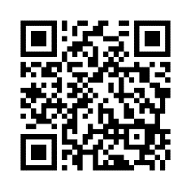
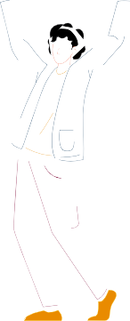
M1: information sheet Klaus Tabori
Student activity - phase I
Create the CO₂ balance for Klaus Tabori using the UBA-CO₂ calculator (ca. 20 min).
Link: https://uba-dev50.co2-rechner.de/en_GB/
HOUSING
Flat: Klaus lives alone in an 80 square metre rented city flat in an apartment block.
The building, built in 1913, has been fully refurbished to optimise energy efficiency. This means that the windows and heating have been replaced.
Heating: The apartment block is heated with district heating. Klaus‘ annual heating energy requirement is around 5,000 kilowatt hours (kWh).
1 long-distance journey by plane: Please click on
detailed here and enter the dates.
Return flight to Thailand: Hamburg (HAM) to Bangkok (BKK), aircraft type: unknown, economy class, no compensation
FOOD
Klaus is 35 years old, weighs 70 kg and is fairly slim. Although he has an office job with little exercise, he enjoys doing a lot of sport.
As he also works a lot and spends a lot of time with his hobbies and friends, he doesn‘t have much time to spend on cooking and shopping.
He consumes an average amount of dairy products.
He sometimes buys regional and seasonal products, but eats less meat.
ELECTRICITY
Klaus is not on a special electricity tariff and consumes a total of 1,500 kWh electricity per year.
TRANSPORTATION & TRAVEL
Klaus lives in a city and doesn‘t own a car. He cycles to the office almost every day and takes the tram or bus when it rains.
OTHER CONSUMPTION
Klaus works full-time and earns a net salary of around 3,000 euros a month.
Klaus would describe his purchasing behaviour as generous, as he expects to spend around 600€ per month.
Klaus rarely repairs or rents appliances and clothing.
He pays more attention to quality and durability.
Detailed composition of consumer spending:
interior design: 150€,
leisure and culture: 200€,
clothing and shoes:
4 new jeans, 6 new shirts,
1 new jacket, 3 new pair of shoes,
Note: Delete the preset vehicle (red button). Add up the journeys by car sharing and public transport. Enter the total in each case.
Journeys to work:
320 km by public transport
Journeys into the countryside: Klaus likes to go hiking in the countryside. He usually takes the bus and train, but sometimes he also hires a car-sharing car.
car sharing: 600 km
public transport: 1800 km
Klaus has a particular hobby: he likes to buy old furniture, so he rummages around on ebay and often picks up the rarities he buys from quite far away. He usually uses car sharing: 800 km.
electronic devices: 1 new notebook,
1 new smartphone,
1 new coffee machine,
accommodation:
10 nights on a campsite, 10 nights pension,
10 nights hotel 4 stars
Klaus goes on holiday about 4 times a year:
2 holiday trips by ICE to visit friends in another city: 2,000 km,
1 holiday trip in a car-sharing car (camping with a friend): 3,000 km

Slide 8
M2: information sheet Maria Schmitt
Student activity - phase I
Create the CO₂ balance for Maria Schmitt using the UBA-CO₂ calculator (ca. 20 min).
Link: https://uba-dev50.co2-rechner.de/en_GB/
HOUSING
House: Maria lives with her partner and two children.
They live in a 150 square metre rented terraced house.
The building (built in 1960) has not been renovated in terms of energy efficiency.
Heating: The entire terraced house is heated with heating oil, the hot water is also produced centrally by the heating oil boiler.
The annual heating energy requirement is around 1,700 litres of heating oil per year.
FOOD
Maria weighs 60 kg and is quite slim. She has a job that entails some movement (light physical labour), but she does little sport.
The family eats an average amount of meat.
Maria eats an average among of dairy products.
Maria likes to shop in large supermarkets so that she can get everything she needs for a week‘s shopping. She also makes sure she eats a balanced diet, partly regional and occasionally seasonal fresh products.
ELECTRICITY
Maria is not on a special electricity tariff. The electricity consumption of the entire household is around 4,700 kWh per year. Most of the electricity consumption is generated by the household.
OTHER CONSUMPTION
Maria works part-time. Together with her partner,
they have a total net income of €2,600 per month.
Maria repairs and rents appliances and clothes rather frequently.
She pays average attention to quality and durability.
Maria‘s purchasing behaviour is rather frugal, and her salary doesn‘t include much. The most important criteria is the favourable price, which is why Maria often buys second-hand.
interior: € 20
leisure and culture: €20
clothing and shoes:
4 jeans, second-hand
2 skirts, second-hand
4 shirts, second-hand
2 jumpers, second-hand
1 jacket, second-hand
1 pair of shoes, new
electronic devices:
1 smartphone, second-hand
TRANSPORT & TRAVEL
vehicles: Maria has her own car,
a 7 year old mid-range car
Fuel: Diesel with an average consumption of approx. 6.1 litres of diesel/100 km
On average, the car is used by 2 people.
Maria drives the car almost every day because she takes the children to school.
Journeys to work by car: 3200 km
Journeys to the grandparents: 2400 km
errands: A little more than once a week for grocery shopping: 720 km
The whole family goes on holiday once a year, then the family often stays in Germany and or travels to neighbouring countries. Distance: 800 km
The family has never flown before.

Slide 9
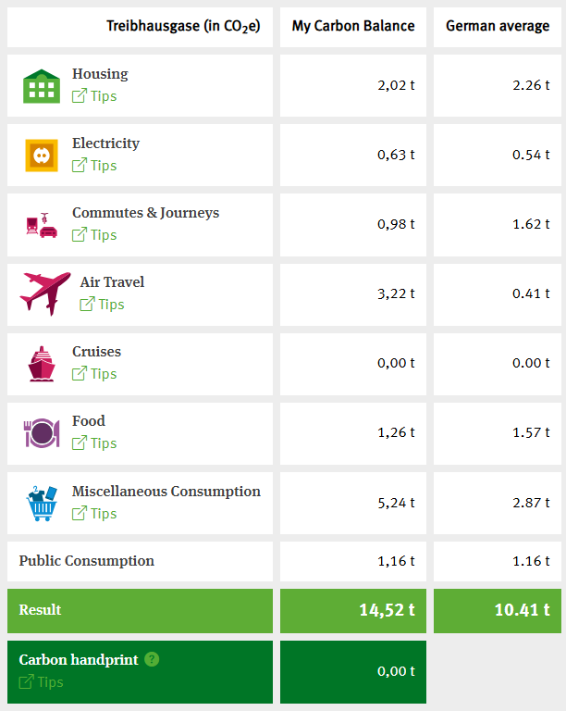
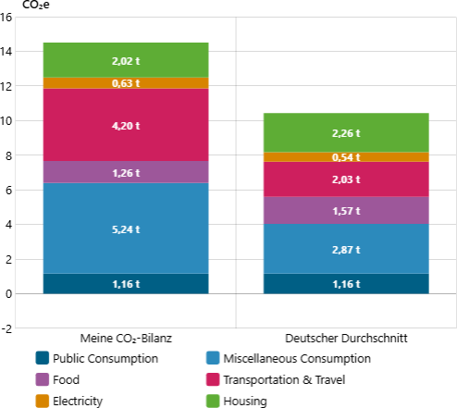
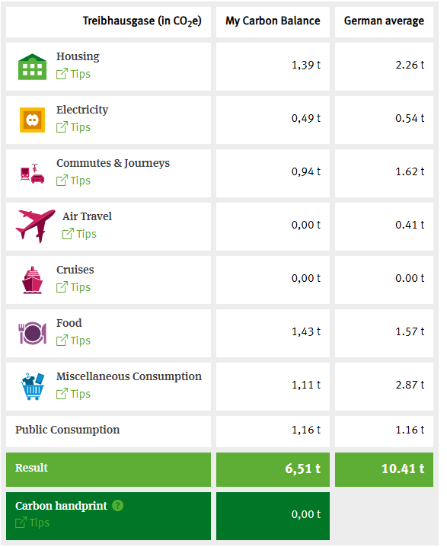
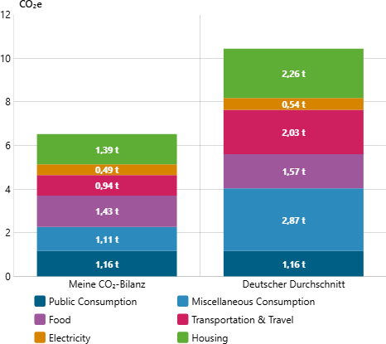
Lö1 & Lö2
Auswertung Arbeitsphase I / Plenum (10 min.)
Die Lehrperson visualisiert die Ergebnisse und stellt sie gegenüber.
➔ Hinweis: Innerhalb einer Gruppe (Maria oder Klaus) kann es durchaus zu kleineren Abweichungen kommen. Hier reicht es aus, wenn die Ergebnisse ungefähr diesen entsprechen: Maria ca. 6-7, Klaus ca. 12-14 Tonnen.
Task: 1. Compare the emission of Klaus and Maria.
CO₂ balance of Klaus Tabori
CO₂ balance of Maria Schmitt

Slide 10
L2 – Comparing the footprints
Task: 2. What causes the differences in emissions?
Classification of Klaus Tabori‘s emissions
Klaus Tabori‘s emissions are 4 tonnes higher than the German average. Klaus would never have imagined this, because his everyday mobility choices are exemplary – he cycles often and takes tram, and he lives in a relatively energy-efficient flat. So what‘s behind his carbon footprint?
Transport/Travel: Flying has a strong influence on Klaus‘ carbon footprint. On average, a person in Germany emits around 0,5 tonnes per year through flights. Klaus‘ flight leaves a footprint of 3.2 tonnes.
Food: Due to his ow-meat diet, Klaus‘ nutrition-linked emissions are well below average. This is despite the fact that men on average have a slightly higher energy requirement than women. In addition, Klaus does a lot of sports, which is healthy but require a higher food intake.
Consumer behaviour: The high level of consumer spending per month leads to significantly higher
emissions than the average.
Classification of Maria Schmitt‘s emissions
Maria Schmitt‘s emissions are around 4 tonnes below the German average. This is despite the fact that she uses oil to heat her home, uses her car and eats meat regularly. There are other reasons for Maria‘s
„good“ balance sheet:
Housing (heating and electricity): Maria lives compactly, with 4 people on 150 square metres, which is well below the German national average of around 43 square metres per capita. The fact that she does not do better is only due to the CO₂ -intensive oil heating system. Electricity consumption is very good for a family of four, and the number if appliances in the household is also limited due to the income.
Transport & Travel: Despite this, Maria travels with significantly lower emissions. Maria uses the car frequently, but only for relatively short journeys. The car is usually occupied by several people and there are no long-distance journeys involving many kilometres. In particular, the family does not fly.
Food: Maria is just below average here. This is because, as a women, she has a slightly lower energy requirement. Otherwise, she eats an „average“ mixed diet, i.e. meat almost every day, like the vast majority of Germans.
Consumer Behaviour: Maria‘s income means that she has to consume sparingly. This leaves her with around 150 euros in consumer spending per month, placing her emissions well below the German average. Borrowing and repairing appliances and clothing also reduce her footprint.

Slide 11
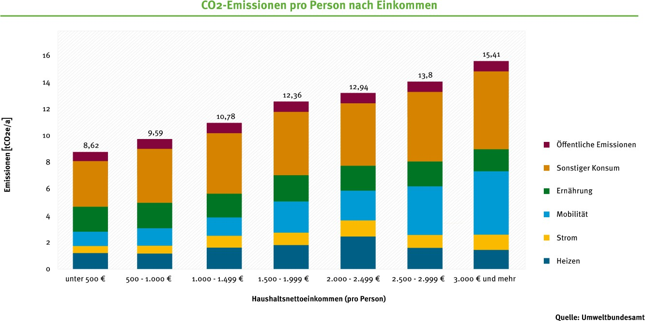
L2 – Comparing the footprints
Comparison of Klaus and Maria
If you compare the two people, you can recognise the following important factors:
Housing: In addition to the level of heat consumption and the type of heating (energy source), the living space also plays an important role.
Transport / Travel: Klaus‘ emissions are more than twice as high as Maria‘s – a transatlantic flight causes high emissions.
Food: As a sporty man, Klaus statistically needs more calories than Maria, who tends to do less sport. However, thanks to his reduced meat consumption, he still causes fewer greenhouse gas emissions than Maria.
Consumption: Klaus‘ high emissions are also due to his 5-fold higher consumer spending.
All of these aspects are strongly influenced – usually negatively – by income and the disposable monthly budget. However, the main exceptions are thermal insulation, electric cars and organic food, where a higher income has a positive environmental impact.
Abb. correlation between income and CO₂-emissions
The level of disposable income has a very strong influence on the environmental impact of our consumption. The higher the income, the more CO₂ emissions a person causes. There are two main reasons for this: higher emissions from mobility and an overall higher level of consumption. High earners often have a larger car or several cars, drive longer distances and often travel by plane on holiday. In addition, their higher income enables them to demand more services such as hotels and restaurants. It is true that environmental conscious people with higher incomes are endeavouring to reduce their carbon footprint in everyday life. However, their efforts, which typically focus on nutritional issues or the energy efficiency of household appliances, are often not enough to offset the negative effects of the main
drivers‘ of mobility and holidays.
More information on: https://denkwerkstatt-konsum.umweltbundesamt.de/geld

Slide 12
L3 – summary
Important adjustments
Housing:
Insulation standard, living space per capita and choice of energy source (e.g. oil for heating) have a significant impact on the CO₂-balance.
Compact living spaces are more efficient because they have less outdoor space in relation to the living space.
Transport / Travel:
Air travel – especially long-distance journeys – is the biggest driver of mobility emissions.
Make shorter journeys more climate-friendly (e.g. switch to bicycles / pedelecs).
Food:
Meat consumption has a strong influence on the CO₂-balance.
A plant-based diet and the purchase of meat substitutes reduce greenhouse gas emissions.
Consumption:
Income and spending behaviour are usually directly related to the level on consumption emissions.
Lower consumer spending results in a better balance.

Slide 13
M3: information sheet Klaus Tabori
Student activity: Klaus
Klaus is taking part in a climate challenge. He wants to reduce his footprint.
Develop measures for Klaus and help him to reduce his CO₂ balance.
Experiment with the CO₂-calculator and observe
how the emissions change when you adjust the inputs.
Find potential savings of 3 tonnes or more. How can Klaus save the most CO₂?
Reflect the savings:
Are the measures that Klaus can cope with and implement or are they major cuts?
What changes in his lifestyle would result form the savings?
Get creative: Design a poster / a presentation / a comic or
write a newspaper article in which you present Klaus‘ successes form the
climate-challenge. Use the following topics.
Explain what measures Klaus has taken to reduce emissions (housing, electricity, transport / travel, food, consumption). How many tonnes of CO₂ were avoided?
Also report on the changes that a more sustainable lifestyle has brought for Klaus.
Pick up on the obstacles and limitations Klaus faces that he cannot change on his own. Develop ideas on how these can be overcome.
Comment on the statement: Sustainable consumption is a joint task, a task for society as a whole.

Slide 14
M4: information sheet Maria Schmitt
student activity - Maria
Maria has won the climate-lottery.
She will receive funding for several measures to reduce her footprint.
Calculate Marias‘ new CO₂ footprint:
Installation of a heat pump powered by green electricity.
One year to cover costs of switching to green electricity.
Swapping the old combustion engine car for an electric car (used: 7 years)
Note: E-cars have higher emissions during production. The calculator
distributes the manufacturer‘s emissions according to the average period of use,
but not evenly, but with higher annual values in the first few years. Therefore, select 7 years as the age to obtain a normal average value.
Inspired by the idea of living more ecologically, Maria gives up eating
meat and sausages for a year.
Reflect on the following topics:
What potential savings would Maria have had without the climate lottery?
Have the measures led to changes in her lifestyle?
Maria‘s attitude to life and her attitude towards sustainability measures?
What role could state subsidy programmes for electric cars, heat pumps and green electricity play in supporting people with lower incomes?
How do you rate such support programmes?
Get creative: Design a poster / a presentation / a comic or
write a newspaper article in which you portray Maria as the winner of the climate-lottery. Use the following topics:
Winning funding measures with CO₂ savings
Effects on Maria‘s life, including her attitude to life
Discuss the idea that people with lower incomes receive state subsidies to enable them to live more sustainably.
Comment on the statement: Sustainable consumption is a joint task, a task for society as a whole.

Slide 15
Lö3 – savings potential Klaus
savings potential Klaus (4 - 5 tonnes CO₂)
switch to green electricity: minus 0.63 tonnes of CO₂
avoiding flights: minus 3.22 tonnes of CO₂
reduction in consumer spending: at least minus 1 tonne of CO₂ possible Further variables:
switch to renewable energies heating: minus 0.1 tonne of CO₂
reduction in heating consumption: minus 0.65 tonnes of CO₂
transport: reduce journey
options:
High income enables Klaus to switch to green electricity, e-car-sharing, etc.
High consumer spending can be reduced. Room for manoeuvre available.
Limitations:
rented flat, heat pump can only be changed by owner
Reducing consumer spending would change lifestyle, but this also requires personal willingness.

Slide 16
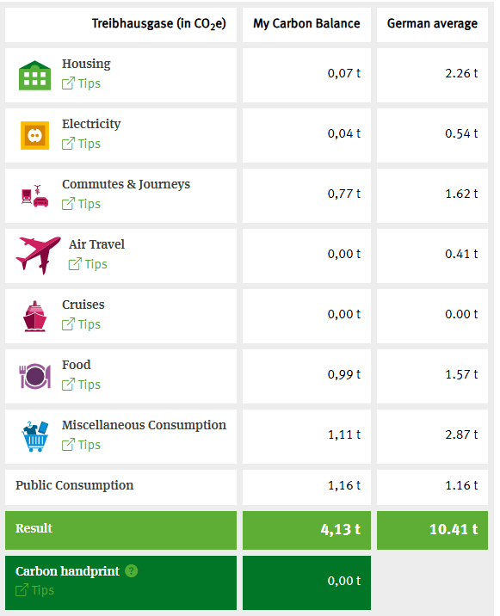
Lö4 – savings potential Maria
Savings potential Maria (about 2.6 tonnes of CO₂)
switch to green electricity: minus 0.45 tonnes of CO₂
heat pump with renewable energy even: minus 1.32 tonnes of CO₂
e-car: minus 0,4 tonnes of CO₂
avoiding meat: minus 0.51 tonnes of CO₂
options:
Savings potential without the profit would be relatively unrealistic due to the already low ecological footprint and the limited financial resources. Avoiding or reducing meat would be a possible starting point without additional expenditure.
lifestyle is partially affected
possibly switching to refuelling the electric car
Giving up meat entails changes in everyday life.
Green electricity and heat pumps have no influence on everyday activities.
Attitude towards life: Being able to practise a more ecological lifestyle that would otherwise not have been affordable could increase the feeling of social participation.
Role of support programmes:
Can promote social participation in the ecological transition and be important levers,
Make sustainable lifestyle accessible to a broader section of the population,
However, support programmes are also cost-intensive and promote individuals,
An additional lever is to organise the public infrastructure ecologically (switching district heating to renewable energies, etc.). This change does not require any individual behavioural change had has enormous savings potential.

Slide 17
L4 – Final reflection & summary
Final reflection
Comparing the savings potential of Klaus and Maria
In which areas do Maria and Klaus alone have no room for manoeuvre due to other barriers?
Klaus: lives in rented accommodation – heat pump not possible
Klaus: changing consumptions habits is possible, would involve lifestyle changes
Maria: income is a limiting factor, many measures cannot be financed (e-car, insulation)
What role could politics play in enabling sustainable lifestyles?
Targeted promotion of climate protection measures for middle and lower incomes. Ensure social justice.
Promotion of sustainable technologies
Expansion of infrastructure (public transport, heating network)
Promotion of community solutions: car-sharing, repair cafés, etc.
Tax incentives for sustainable consumption e.g. no VAT on plant-based products
summary
Identifying major levers helps to significantly reduce individual CO₂ emissions (transport, food, living space, insulation standard).
Many climate protection measures are associated with high financial investments. Support programmes
are important for people who do not have this money.
Support programmes must be initiated by politicians.
However, politicians also support people when the public infrastructure is ecologically converted and expanded: Expansion of local public transport, insulated housing, conversion to renewable energy sources in the municipal heat supply, promotion of plant-based food in canteens and cafeterias.

